Slide 1
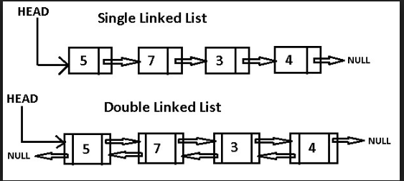
Data Structures
Linked Lists

Slide 2
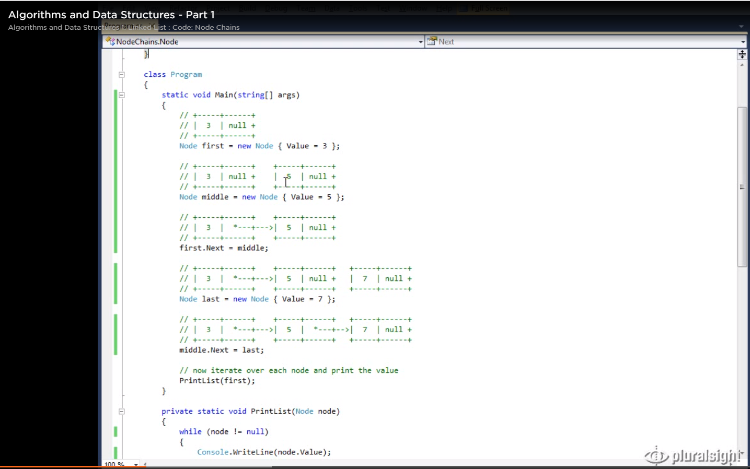

Slide 3
Data Structures

